Slide 1
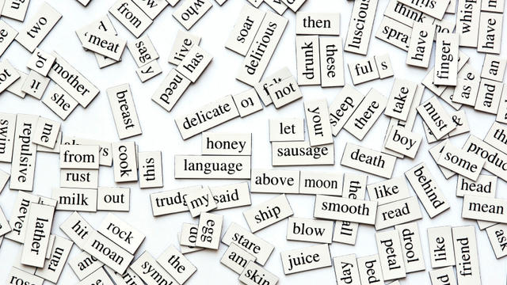
Scraping and Natural Language Processing

Slide 2

Scraping Data From Twitter

Slide 3
Some examples of Twitter data in papers
Do brand tweets that use clever humor receive more engagement (likes, retweets, replies) than other tweets? (Howe et al., 2020)
Qualitative coding of #MeToo tweets scraped from Social Movement organizations to examine how these organizations mobilize (Xiong et al., 2019)
Quantitative modelling of the best way to respond to consumer complaints on Twitter (Ma et al., 2015)

Slide 4

Learning Goals for Today
You will leave this class knowing all the steps to follow to scrape Twitter, even if you don’t know anything about coding.
You will be able to use this pdf as a reference if you ever need to scrape Twitter data
We will NOT go through all the possible pathways to scraping. I just want you to completely understand one way of doing it.
Some people do this through a Twitter API. This does not.
Notes:
Here are the learning goals for today.
I have often felt frustrated when people try to teach me to scrape because they went too broad and theoretical. My goal today is to give you a step-by-step guide on how to scrape twitter and to make this PowerPoint as detailed as possible so that you can use it as a reference.
I am not a coder. This is the way that has worked for me. If you have computer programming friends, they may know a more efficient way. All I know is that this way *Works*. I’m not claiming it’s the best way, but it is the most accessible way for non-coders to get started.

Slide 5

Agenda
What do I need to install?
What’s the most basic way to scrape Tweets?
What if I need to scrape information about Twitter users?
What if I need to embed tweets into Qualtrics?

Slide 6
What do I need to get started?
Install Python to your computer (https://www.python.org/downloads/)
Open your Terminal App (Mac) or Command Window (PC)
On Mac: Applications > Utilities > Terminal
On PC: Type cmd in the Windows search bar and click ”Command Prompt”
Install Pip (https://pip.pypa.io/en/stable/installing/)
On Mac: https://www.geeksforgeeks.org/how-to-install-pip-in-macos/
On PC: https://phoenixnap.com/kb/install-pip-window (Follow the instructions beginning at “Installing Pip on Windows” --- DO NOT start with the earlier instructions).
Install Jupyter Notebook
Follow the commands for pip install: https://jupyter.org/install

Slide 7
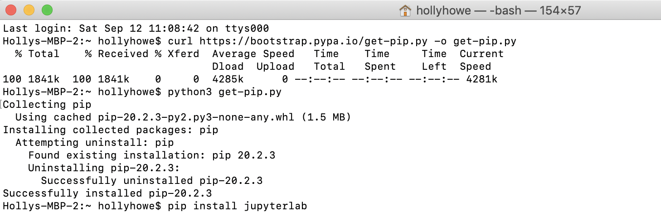

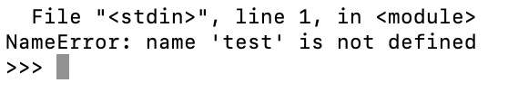
What do steps 3 & 4 look like on Mac?
New lines it should look like this:
(with your name obviously)
You’ve made a mistake if it looks like this

Slide 8
Install Twint (The Twitter Scraper)
You should be able to do this in Jupyter, but I ran into problems. So install it right in your command line
pip3 install --user --upgrade git+https://github.com/twintproject/twint.git@origin/master#egg=twint

Slide 9

Congratulations! Installing that software is the hardest part! Now, let’s actually scrape some data!

Slide 10
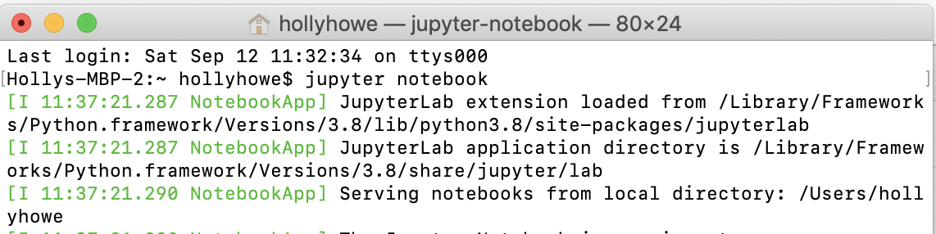
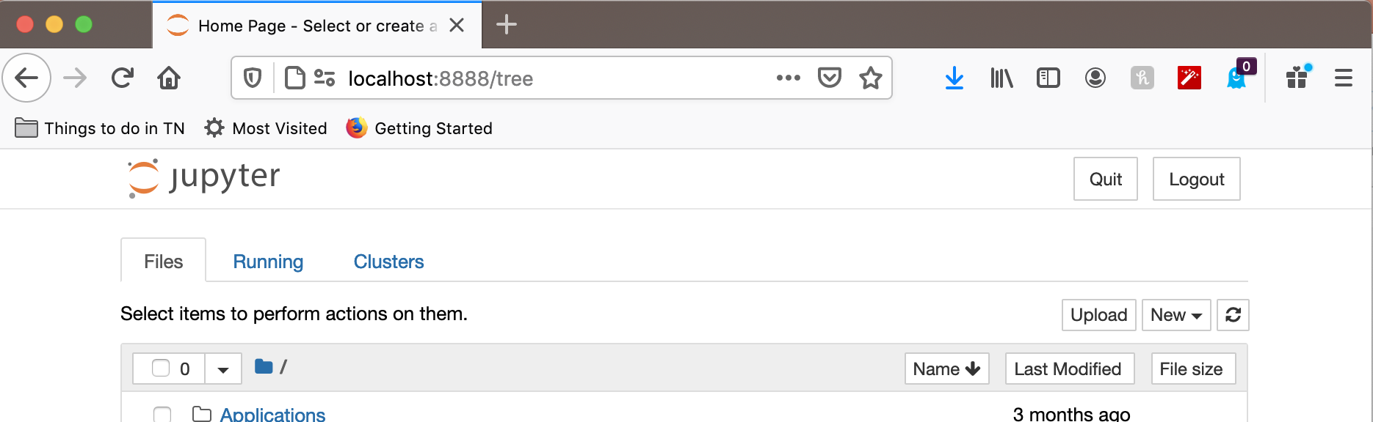
Step 1: Launch Jupyter Notebook
Type “jupyter notebook” into your terminal
Jupyter Notebook will open in your default web browser

Slide 11
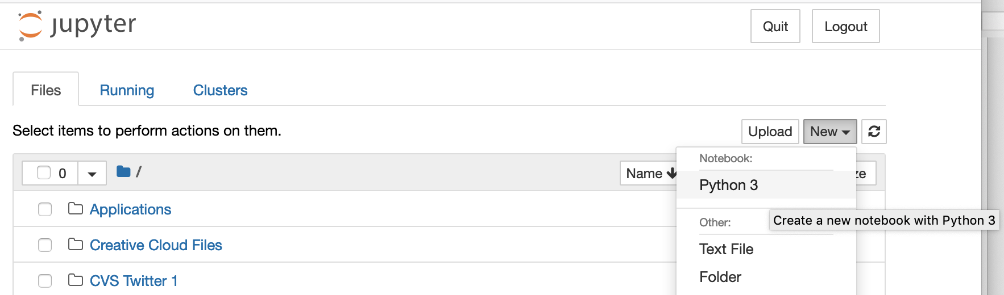
Step 2: Create a New Project
Select “New” and then ”Python 3”

Slide 12
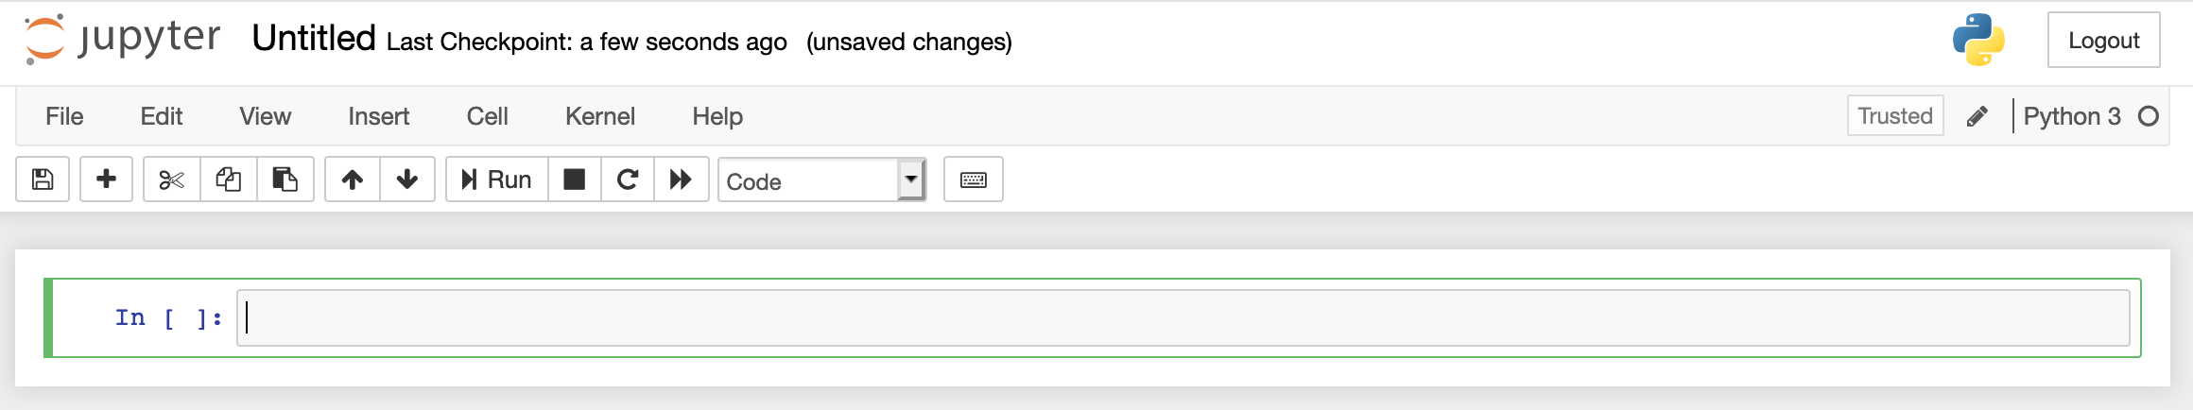
Your new notebook
This is the run button, press it after every command
This is the command line where you enter the actions you want the program to run

Slide 13
Step 3: Install Pandas
Type this exactly into the command line (then click run)
!pip3 install pandas
import pandas as pd

Slide 14
An example What information do you need to collect?

Slide 15

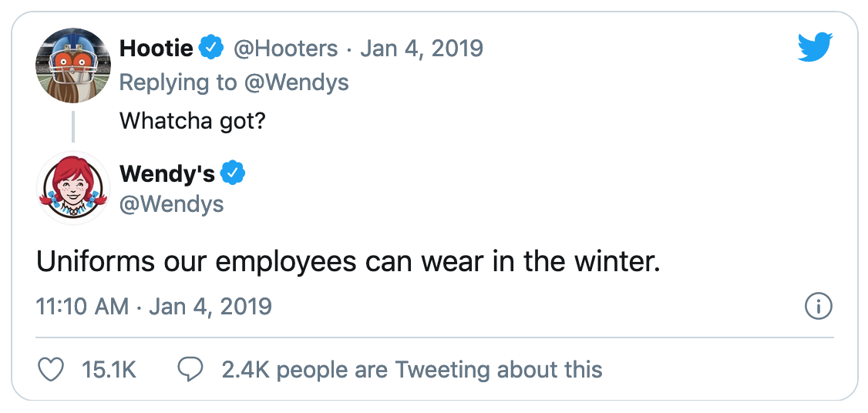

Slide 16
Twitter
Engagement
Teasing

Slide 17
Who tweeted @Wendys on International Roast Day?

Slide 18
Scraping Tweets from #NationalRoastDay
In my Jupyter notebook, I typed…
Using the Twint program
!twint -s "@Wendys" --since "2021-10-12" -o file.json --json
Pull Tweets with the phrase “@Wendys”
Since October 12
Save the file as a json dataframe called “file.json”

Slide 19
Saving the scraped tweets
Our overall goal here is to convert the scraped tweets (currently in json) to an excel document that we can work with
Using pandas, create a table by reading the json file we just created
df = pd.read_json('/Users/hollyhowe/file.json', lines = True)
Delete the column called “created_at” because it contains timezone info, which can’t be exported to excel
del df['created_at']
Save that table to a place on our computer
df.to_excel(r'/Users/hollyhowe/Downloads/test.xlsx', index = False)

Slide 20
The Output
Date
Replies
Tweet Text
Tweeter’s Username
Retweets
Hashtags
@’s Username
Favorites
Permalink

Slide 21
Who did Wendys Tweet at on International Roast Day?

Slide 22
Scraping Tweets from #NationalRoastDay
In my Jupyter notebook, I typed…
Using the Twint program
! twint -u Wendys --since 2021-10-12-o file.json --json
Pull Tweets from the username “Wendys”
Since October 12
Save the file as a json dataframe called “file.json”

Slide 23

Content Analysis

Slide 24

The Very and Very Accurate Way (Human Coders)

Slide 25
What can be coded?
Archival materials
Communications
Media, social media (web scraping), advertisements
Interviews
Projective measures (personality research)
Open-ended responses (e.g., descriptions, memories)

Slide 26
How to Come up with a Coding Guide?
What to code for?
Hypothesis
Literature
Existing coding scheme
What does your data show?
Unit of analysis? (molar vs molecular) “coding units”
Nominal (category coding) or interval (dimension coding)?
Rules

Slide 27

An Example (and an exercise)

Slide 28
Intercoder reliability
Nominal: cohen’s Kappa
In SPSS: Analyze…descriptives…cross tabs… 2 raters are row and column, click on “kappa” under “statistics”
Interval: Intraclass correlation coefficient (ICC)
In SPSS: Analyze…scale…reliability analysis….2 raters under “items”. Click on “intraclass correlation coefficient” under “statistics”
Model: one-way random if not same raters for all cases; 2-way random otherwise
Output: look at “average measures” ICC value

Slide 29
The Expensive and Accurate Way (MTurk Coders)

Slide 30
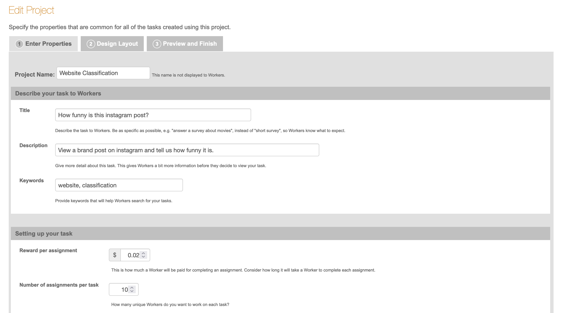
The fastest way to rate a bunch of tweets
MTurk (NOT cloudresearch) > New Project
Website Classification

Slide 31
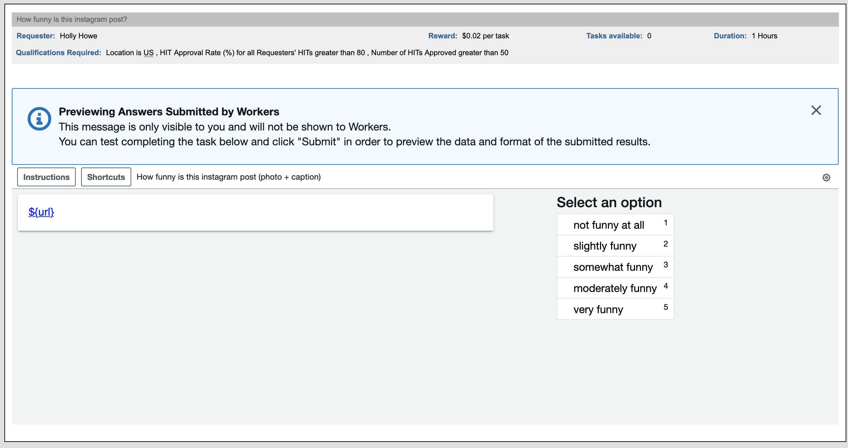
The fastest way to rate a bunch of tweets

Slide 32
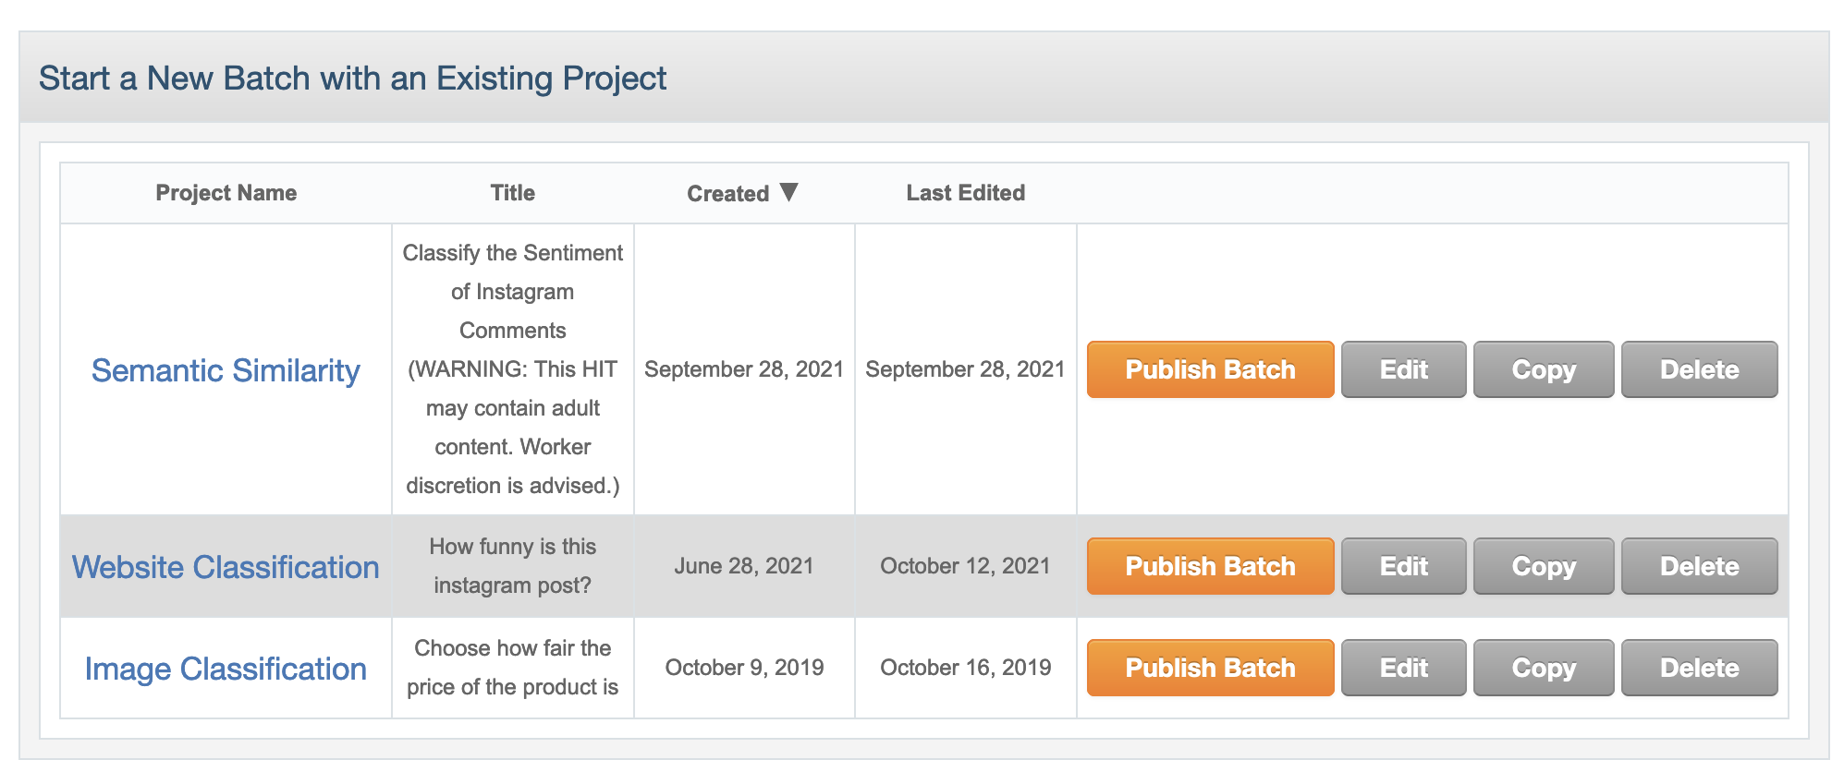
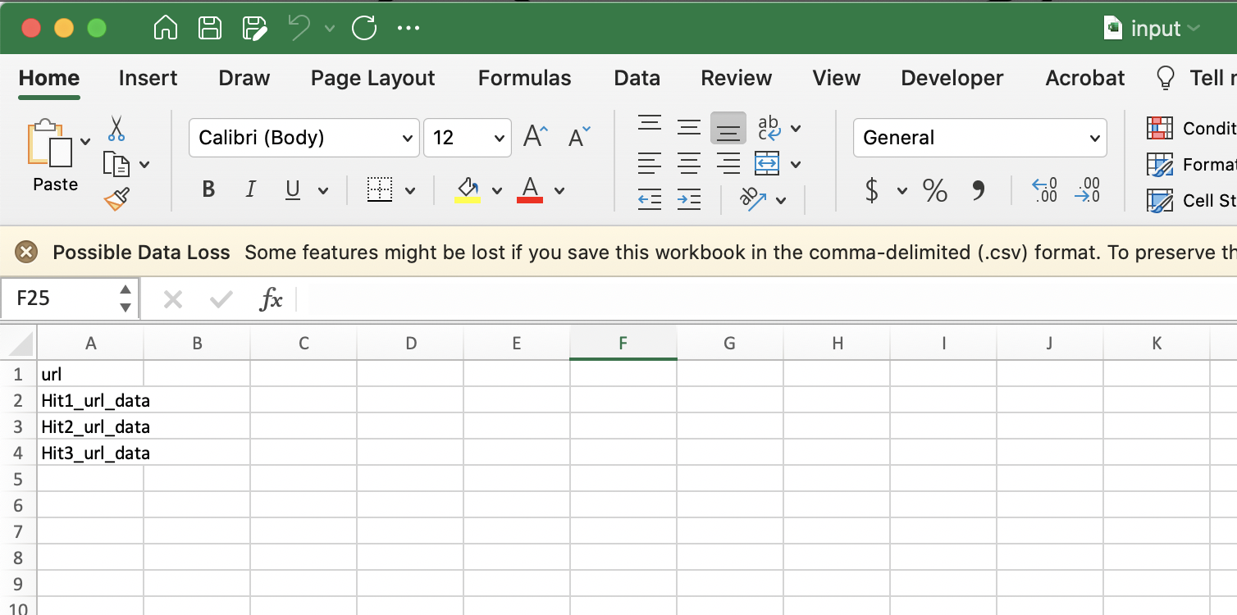

Slide 33
Do the sentiment of tweets @Wendys change on #NationalRoastDay compared to other days?

Slide 34

The Cheap and Fast Way (NLPs)

Slide 35

Linguistic Inquiry and Word Count (LIWC)
Lifetime Membership: $89.95
Counts words across various dictionaries
Analytical Thinking
Clout (i.e., expertise)
Authenticity
Emotion (positive, negative)
Comparison words
Time Orientation
Personal pronouns

Slide 36
There Are Many Things LIWC Can’t Do
Sentiment analysis (overall valance/arousal of the effect)
Concreteness of the text
Sarcasm in text
Etc

Slide 37
Non-LIWC Text Analysis

Slide 38
Steps of Natural Language Processing
Remove hashtags, symbols, emails, etc
Tokenization (breaking a sentence into individual words)
Remove stopwords (e.g., a, the, and, it, for, but, my, your)
Lemmatization (transforming words into a common form)
Example: Ate, eaten, eats ---> eat
Combine the cleaned tokenized words back into a string
Run the actual text analysis (I will show you sentiment analysis, but you can do a variety of analyses)

Slide 39
Step 0: Preparing our Jupyter Notebook
1. Install the programs we will need to run the analysis
!pip install nltk
!pip install openpyxl
!pip install pandas
2. Import the programs we will need to run the analysis
import pandas as pd
import nltk
from nltk.corpus import stopwords
from nltk.tokenize import word_tokenize
from nltk.stem import WordNetLemmatizer
from nltk.sentiment import SentimentIntensityAnalyzer
import re
3. Create a pandas dataframe of your csv file
df = pd.read_excel('/Users/hollyhowe/Downloads/test.xlsx', engine='openpyxl')
print (df)
Notes:
df = pd.read_excel('/Users/hollyhowe/Downloads/test.xlsx', engine='openpyxl')
print (df)

Slide 40
Step 1: Removing hashtags and tags
A text analysis software isn’t going to need #hashtags, urls, or @mentions, so let’s remove them.
def cleanTxt(text):
text = re.sub(r"@\S+",'',text) #Removes @mentions
text = re.sub(r"_\S+",'',text) #Removes words after underscore
text = re.sub(r"#\S+",'',text) #Removes words after hashtag
text = re.sub (r'https?:/\/\S+','',text) #removes hyperlinks
text = re.sub('\W+',' ', text) #removes punctuation
return text
#Cleaning the text
df['string'] = df['tweet'].apply(cleanTxt)
print (df)

Slide 41
Step 2: Tokenization
Purpose: Break sentences into individual words so that we can process the individual words.
df['tokenized'] = df[‘string'].apply(word_tokenize)
print(df)
‘Tokenized’: name of the new column we’re creating
‘String’: name of the column we’re pulling the text from

Slide 42
Step 3: Remove Stopwords
This function removes all the English stopwords in the nltk dictionary
stops = set(stopwords.words('english'))
def stop(row_of_dataframe):
wordsFiltered = []
for w in row_of_dataframe:
if w not in stops:
wordsFiltered.append(w)
return(wordsFiltered)
df['stopword'] = df['tokenized'].apply(stop)
print (df)
P.S. If you’re interested in knowing what stopwords NLTK uses, just type print(stops) into your jupyter notebook

Slide 43
Step 4: Lemmatization
Lemmatization refers to returning all words to an original form (e.g. “ate”, “eaten”, “eats” would all become “eat”)
lemmatizer = WordNetLemmatizer()
def lemma(row_of_dataframe):
wordsFiltered = []
for w in row_of_dataframe:
lw = lemmatizer.lemmatize(w)
wordsFiltered.append(lw)
return(wordsFiltered)
df['lemma'] = df['stopword'].apply(lemma)
print(df)

Slide 44
Step 5: Combining the Clean Tokenized Words Back into a String
def combine(row_of_dataframe):
string = " ".join(row_of_dataframe)
return(string)
df['clean'] = df['lemma'].apply(combine)
print(df)

Slide 45
Step 6: Running Sentiment Analysis 🎉
This will return 4 new columns assessing the positivity, negativity, neutrality and overall sentiment of the tweet
sia = SentimentIntensityAnalyzer()
def sentiment(row_of_dataframe):
sentiment = sia.polarity_scores(row_of_dataframe)
return(sentiment)
df['sentiment'] = df['clean'].apply(sentiment)
df1 = pd.DataFrame(df['sentiment'].tolist())
df = pd.concat([df, df1], axis=1)
del df['sentiment']
print(df)

Slide 46
Additional Resources
Holly Howe (holly.howe@duke.edu)
Me!
Getting MTurkers to rate scraped data (including emoji problems)
NLP on the Google Cloud Platform or in R (in addition to python)
Gaurav Rajesh Parikh (gaurav.rajesh.parikh@dukekunshan.edu.cn)
Amazing comp-sci B-Lab RA
I haven’t used him for scraping, but he seems wonderful
Ash Rahman (ashabur.rahman@duke.edu)
Holly’s RA who scrapes for her
Has scraped Instagram and Twitter for me. Also has code to scrape reverse image searches

Slide 47
Extra Slides

Slide 48
Solve Behaviors
Questions: Asks questions about the problem or how the seeker is coping
Cause: Figures out what is causing the problem, gathers extra information about the problem
Perspective: Gives the speaker perspective, reframes situation, provides insights into the event
Suggestions: Gives suggestions on how to solve the problem (or how to improve mood)
Solution: Gives information to help solve the speaker’s problems (or asks speaker to generate solutions)
Solace Behaviors
Empathy: Shows understanding, mimics emotions
Compliment: Compliments the looks or ability of speaker
Available: Assures speaker of future availability to help with problem, leans forward, doesn’t interrupt
Reassure: Tries to boost the speaker’s self esteem, assures speaker that things will be ok, agrees with speaker, criticizes third party
Lift Mood: (Offer to) engage in mood-improving activities with the seeker
Confidentiality: Assures seeker of confidentiality
Feelings: Asks how the speaker feels and why they feel that way. Encourages emotional displays
Dismiss Behaviors
Avoid Problem: Changes the topic of conversation
Show Disinterest: “I don’t care about problem” or “there’s nothing you can do”
Criticize: Criticize the speaker for how they handled the problem
Minimize: Say the problem is not serious or unique
Sarcasm: Ridicules the speaker, uses sarcasm
Pollyanna: Dismiss the problem by saying its “blessing in disguise” or to “look on the bright side”
Escape Behaviors
Encourage Escape: Encourage seeker to get drunk/high or engage in risky behaviors to escape
Aggressive Joke: makes fun of speaker or speaker’s feelings
Show Irritation: Show irritation at speaker or speakers problem
Suppress: encourage speaker to suppress emotions

Slide 49
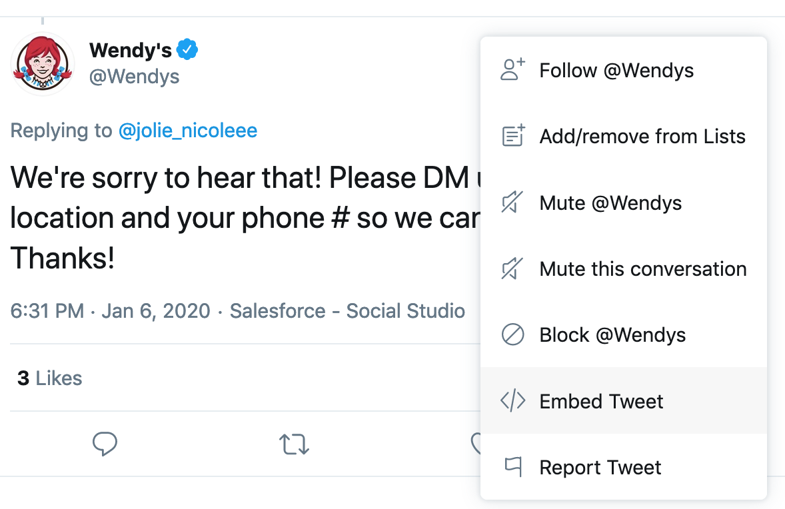
Embedding Tweets
The slow way…
Click the link to the tweet in from your Twint file
Get the embed link

Slide 50
Embedding Tweets
The fast way…
Recall that Twint gives you a link that looks like this
https://twitter.com/Wendys/status/1214328772935266304
You need to transform it into a link that looks like this
https://publish.twitter.com/?query=https%3A%2F%2Ftwitter.com%2FWendys%2Fstatus%2F1214328772935266304 &widget=Tweet
I do this using formula in excel to pull the right information into the new link format

Slide 51
Install Chromedriver
https://chromedriver.chromium.org/

Slide 52
Embedding Tweets
The fast way…
import numpy as np
import pandas as pd
from random import randint
from time import sleep
from selenium import webdriver
def get_result(link):
try:
driver.get(link) #go to the link page
sleep(randint(2,5)) #pause between 2-5 seconds
result = driver.find_element_by_class_name('EmbedCode-code’)#get the Embedding code
result = result.text
except:
result = np.nan
return result
data = pd.read_csv("/Users/hollyhowe/Downloads/Jan2020WendysTweets.csv") #put the link to your specific list of URLS here
driver = webdriver.Chrome(executable_path=r'/Users/hollyhowe/Dropbox/chromedriver’) #put the pathway to your Chromedriver here
test_data = data.iloc[:] #formatting it into a table.
results = test_data.apply(lambda x: pd.Series(get_result(x.link), index = ['html']), axis = 1)
results = pd.concat([test_data, results], axis = 1, ignore_index = True)
results.to_csv("Desktop\\Holly\\html_stuff.csv", sep = "|") #save the file to a specific place on your computer here
import numpy as np
import pandas as pd
from random import randint
from time import sleep
from selenium import webdriver
def get_result(link):
try:
driver.get(link) #go to the link page
sleep(randint(2,5)) #pause between 2-5 seconds
result = driver.find_element_by_class_name('EmbedCode-code’)#get the Embedding code
result = result.text
except:
result = np.nan
return result

